Slide 1
Release-as-code Design sprint
November 2016

Slide 2
Goal
Make XL Release developer-friendly while keeping it friendly for non-developers.

Slide 3
What does that mean?
Allow templates, releases and other configuration objects to be defined as code.
Allow for dynamic definition of those objects.
Allow that code to be stored in SCM.
Provide a developer-friendly language.
Provide non-developer insight into what’s happening.

Slide 4
Choices/decisions
Language:
No JSON – too cumbersome.
No YAML – not dynamic enough.
Still to decide:
Python script or Groovy DSL.
How to invoke:
CLI.
Script task.
SCM trigger.

Slide 5
Requirements
Easy to learn
Compact
Declarative
Idempotent

Slide 6
Scenarios
Automatically setup multiple templates for maintenance branches, from the command line.
Automatically setup new teams, from a script task.
Run a dynamically generated release, from a trigger.

Slide 7
CLI in XL Release
What are we seeing?
CLI
Python DSL

Slide 8
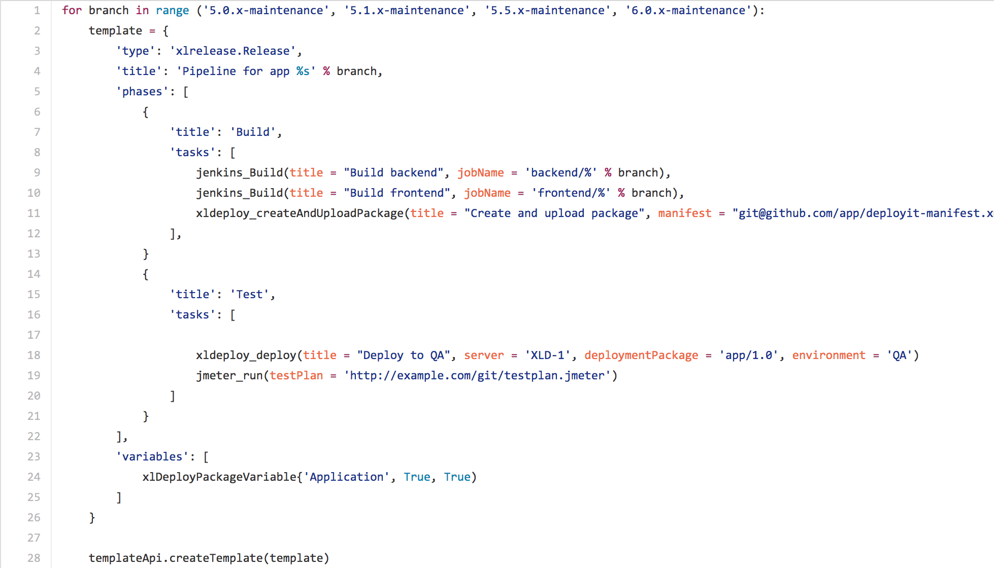
Python DSL

Slide 9
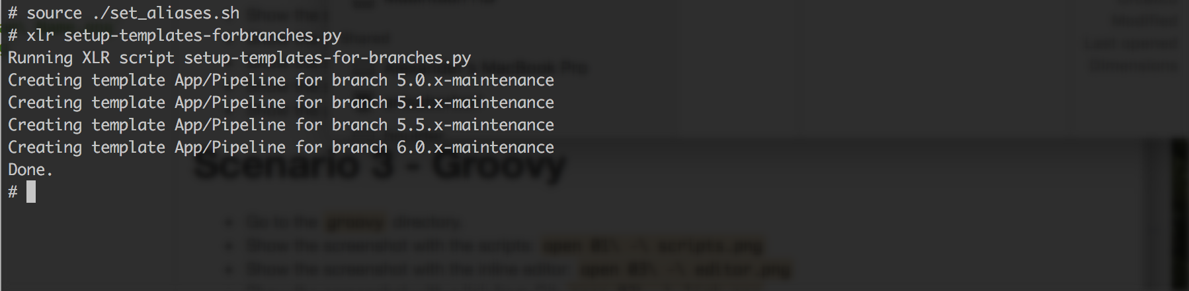
Executing from CLI

Slide 10
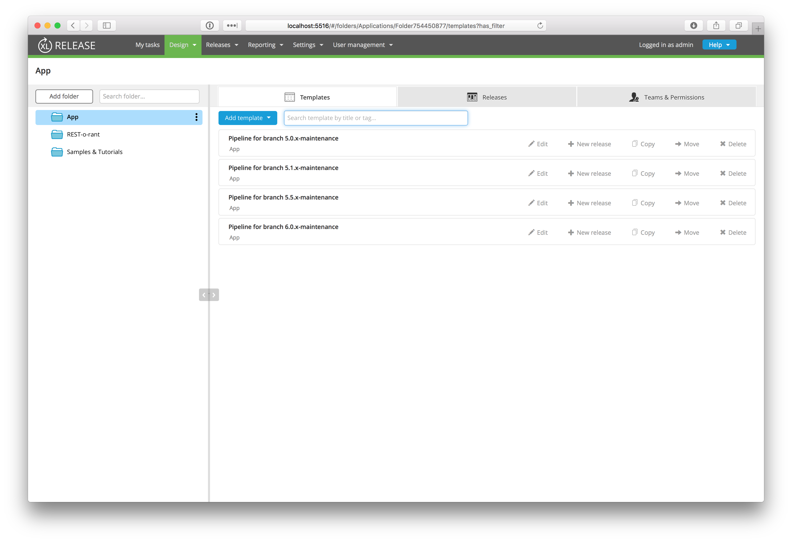
Results

Slide 11
Seeding Template From A Release
What are we seeing?
Script from task in a Release
Script creates a new template
Current Python

Slide 12
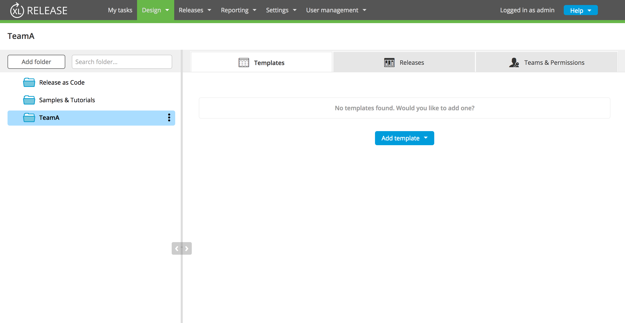
Team Folder

Slide 13
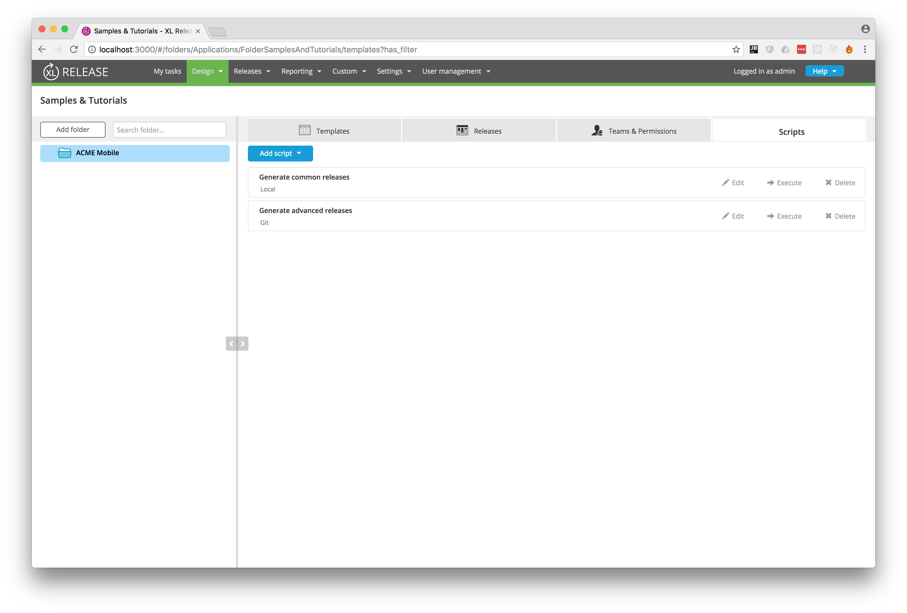
Adding Script Folder

Slide 14
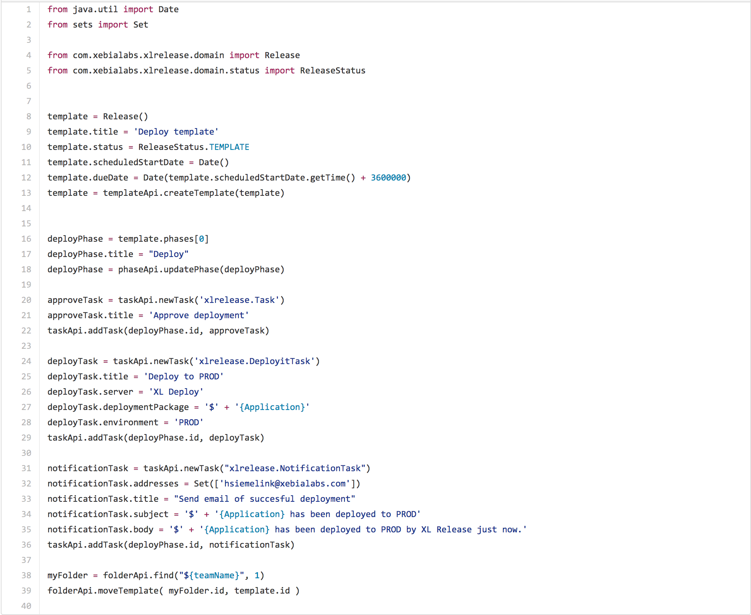
Script

Slide 15
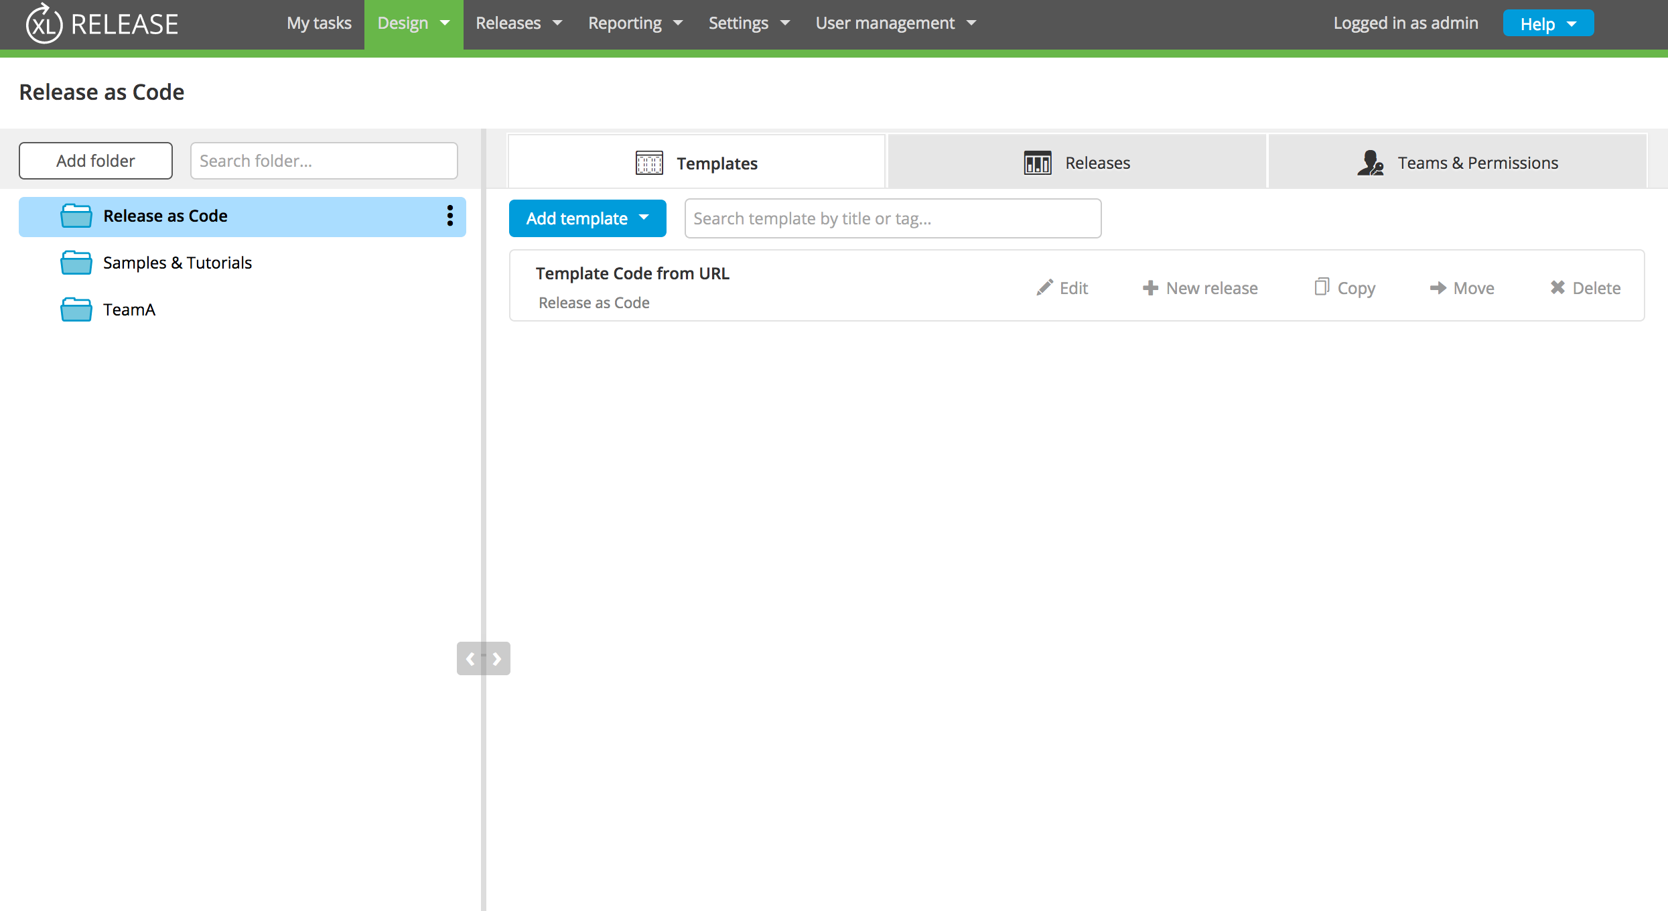
Release as Code Folder

Slide 16
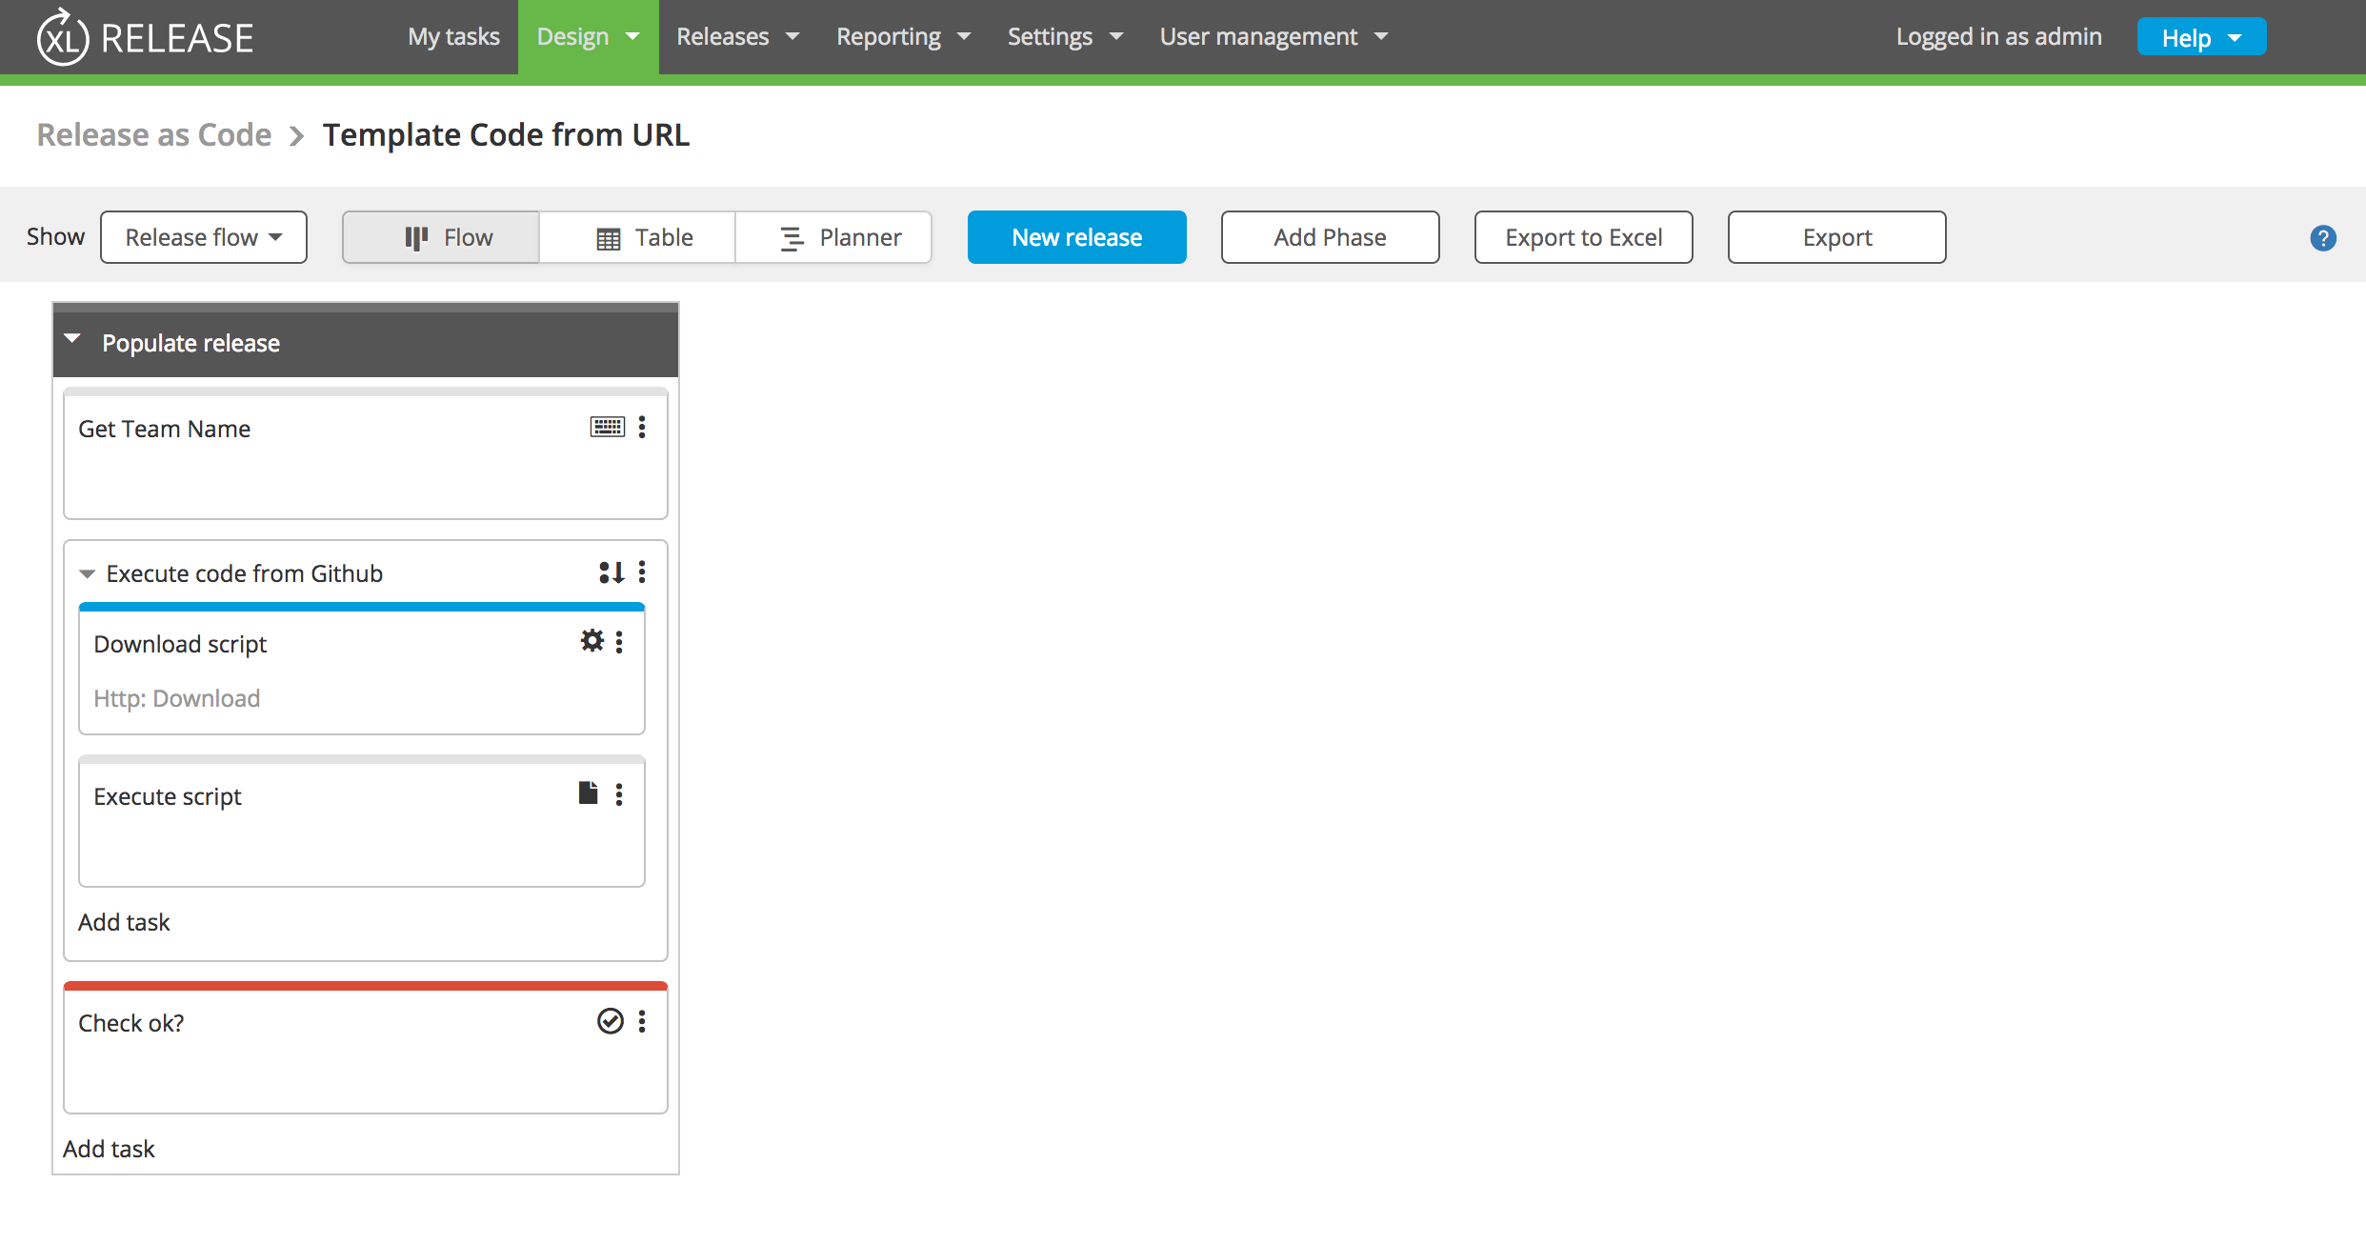
Release Template

Slide 17
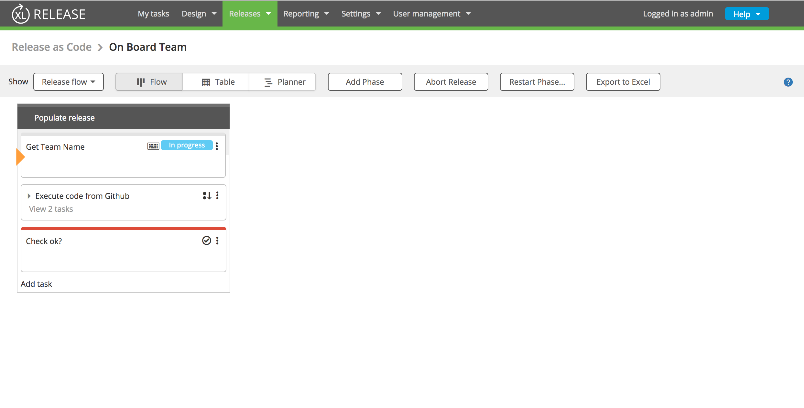
Release Start

Slide 18
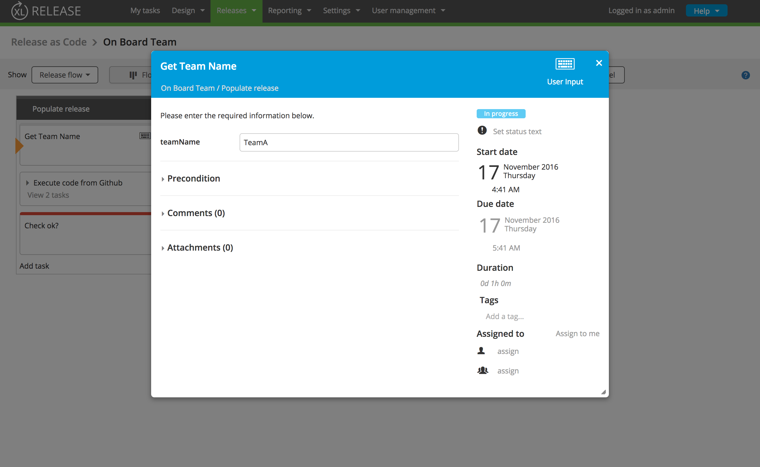
Set Release Team Name

Slide 19
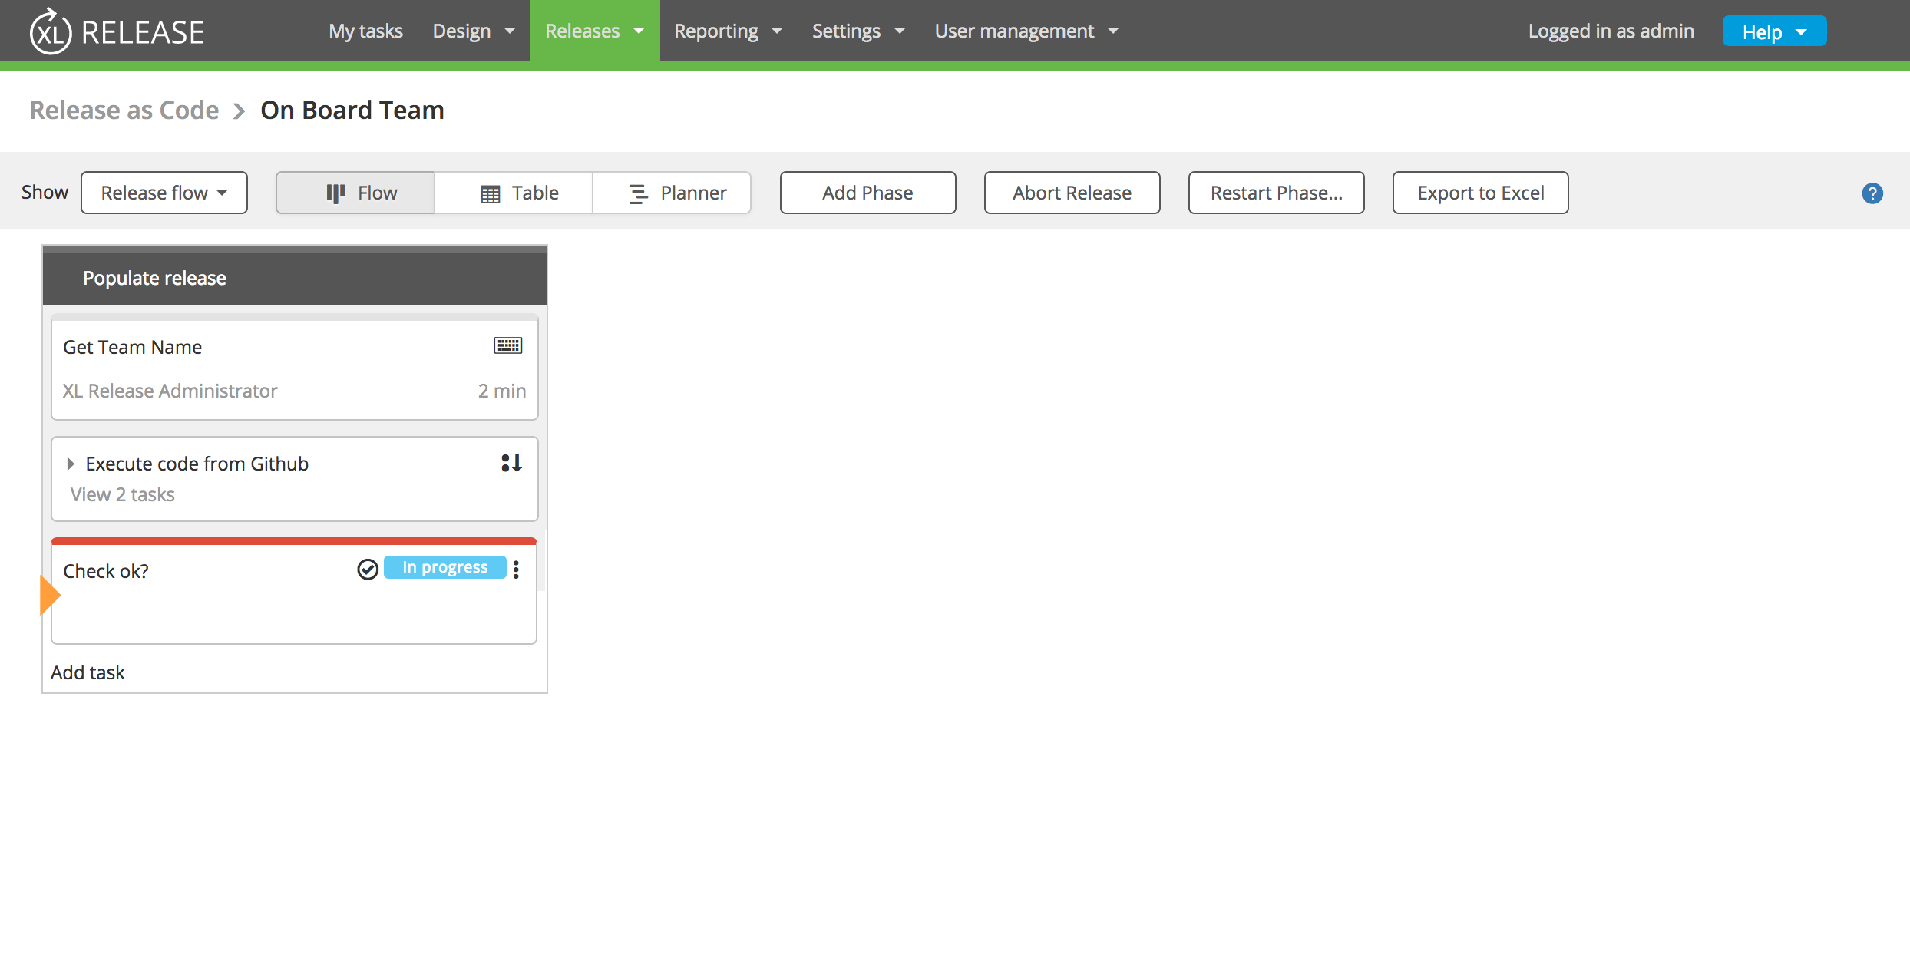
Release Script Executed

Slide 20
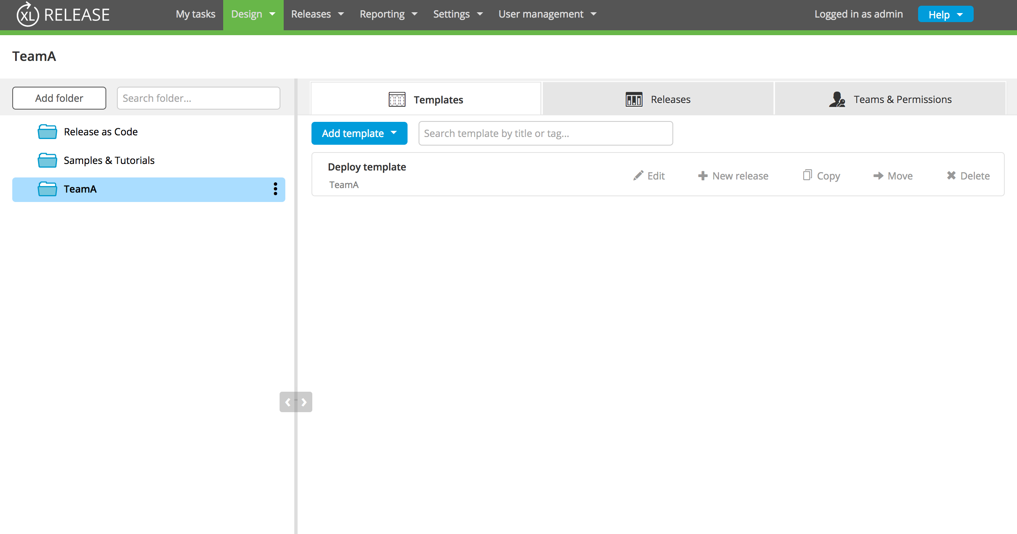
Release Team Folder Updated

Slide 21
Groovy DSL
What are we seeing?
Starting a release from a script
Groovy DSL

Slide 22
Scripts Tab In Folder

Slide 23
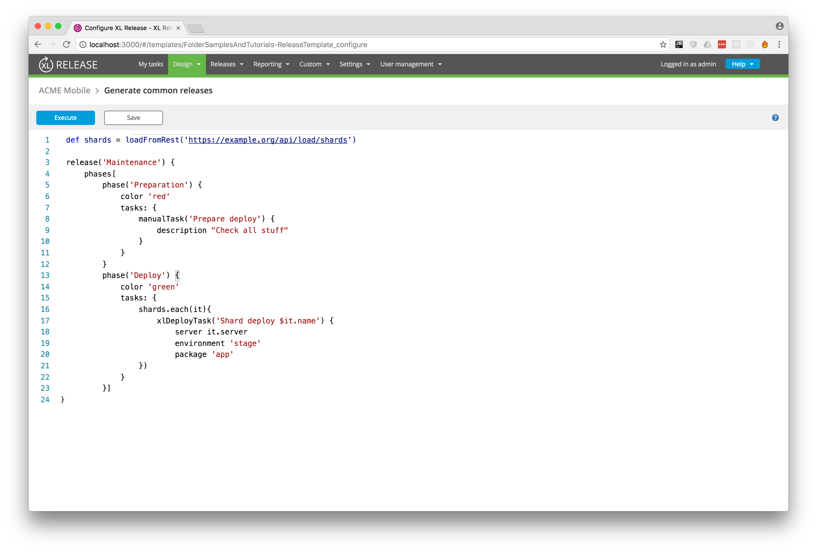
Editor

Slide 24
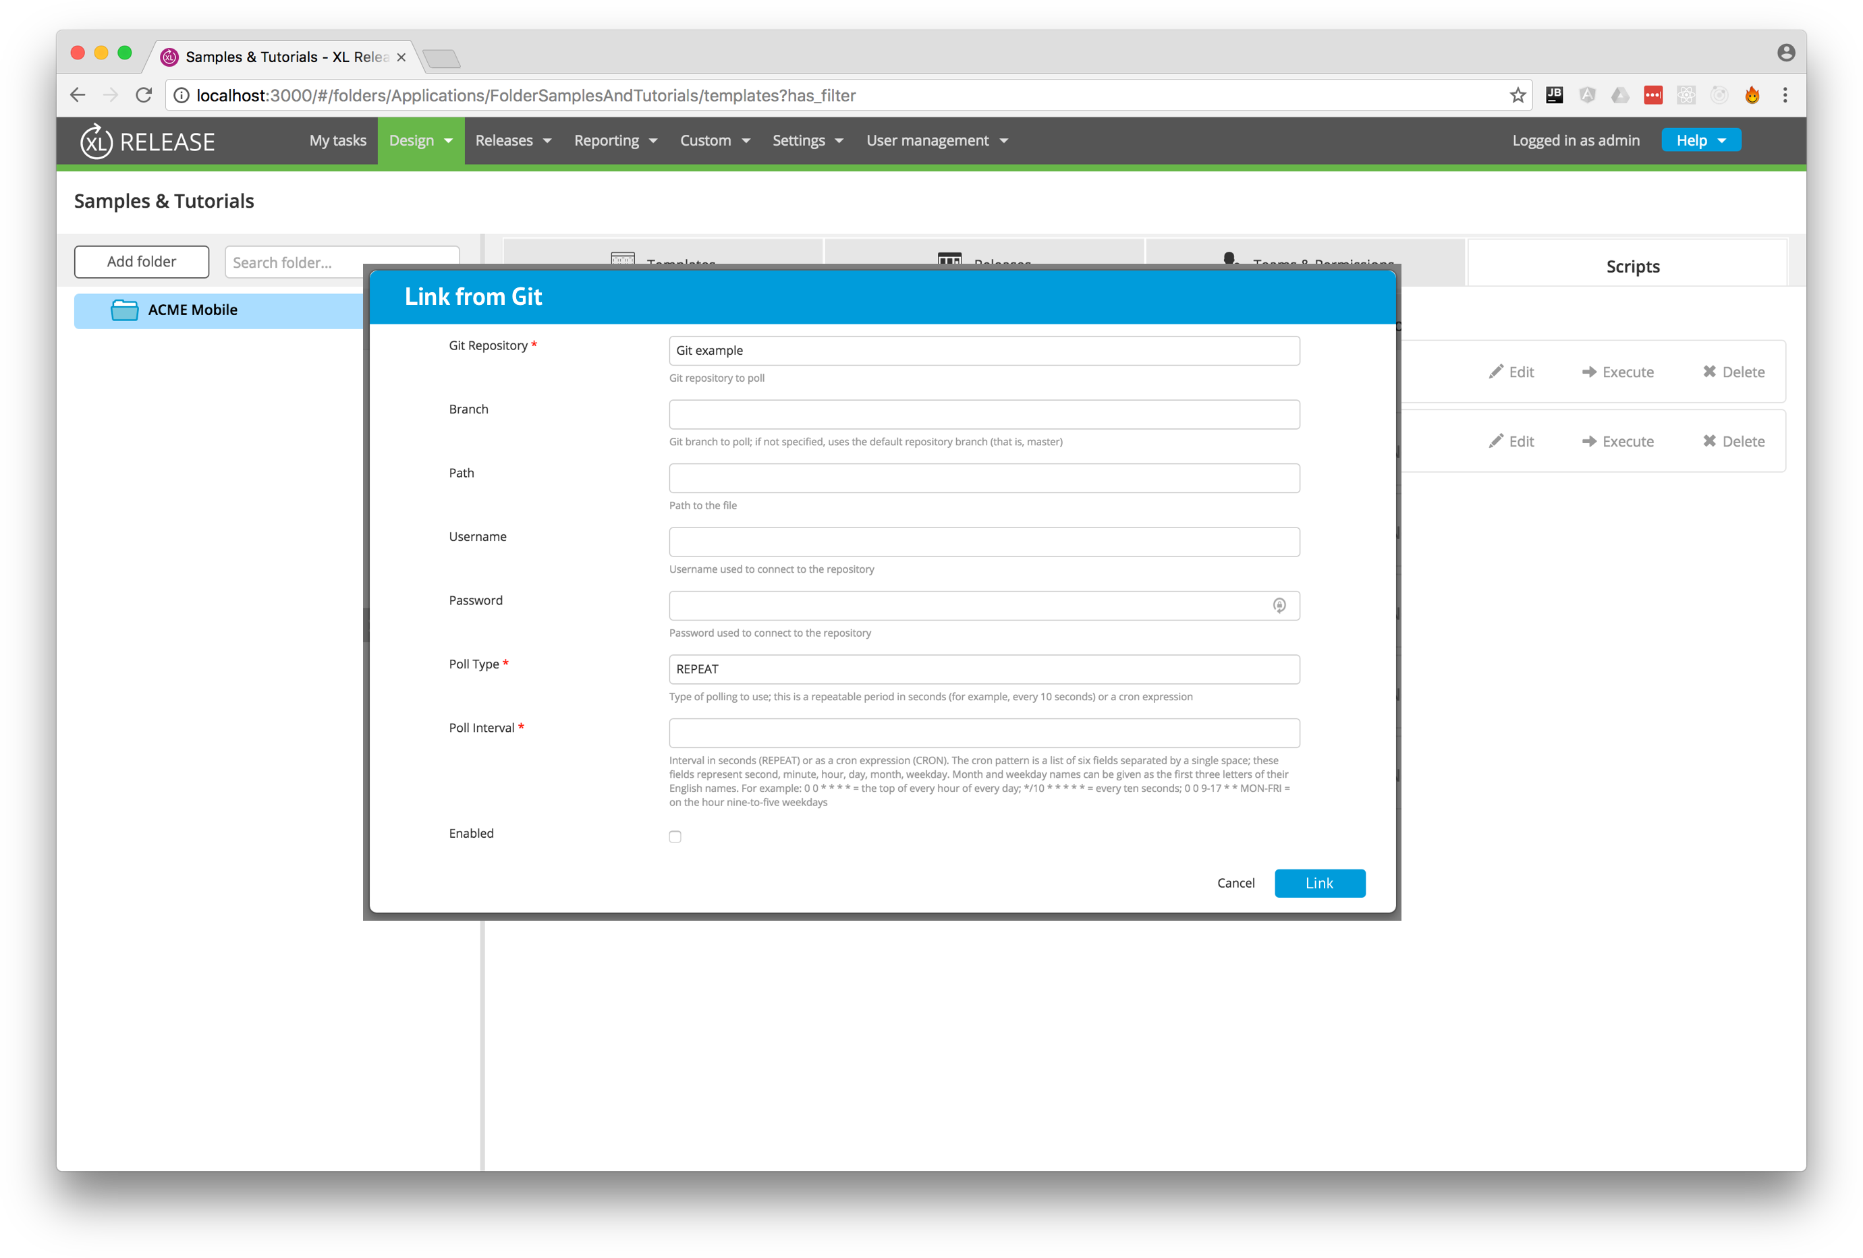
Link to SCM

Slide 25
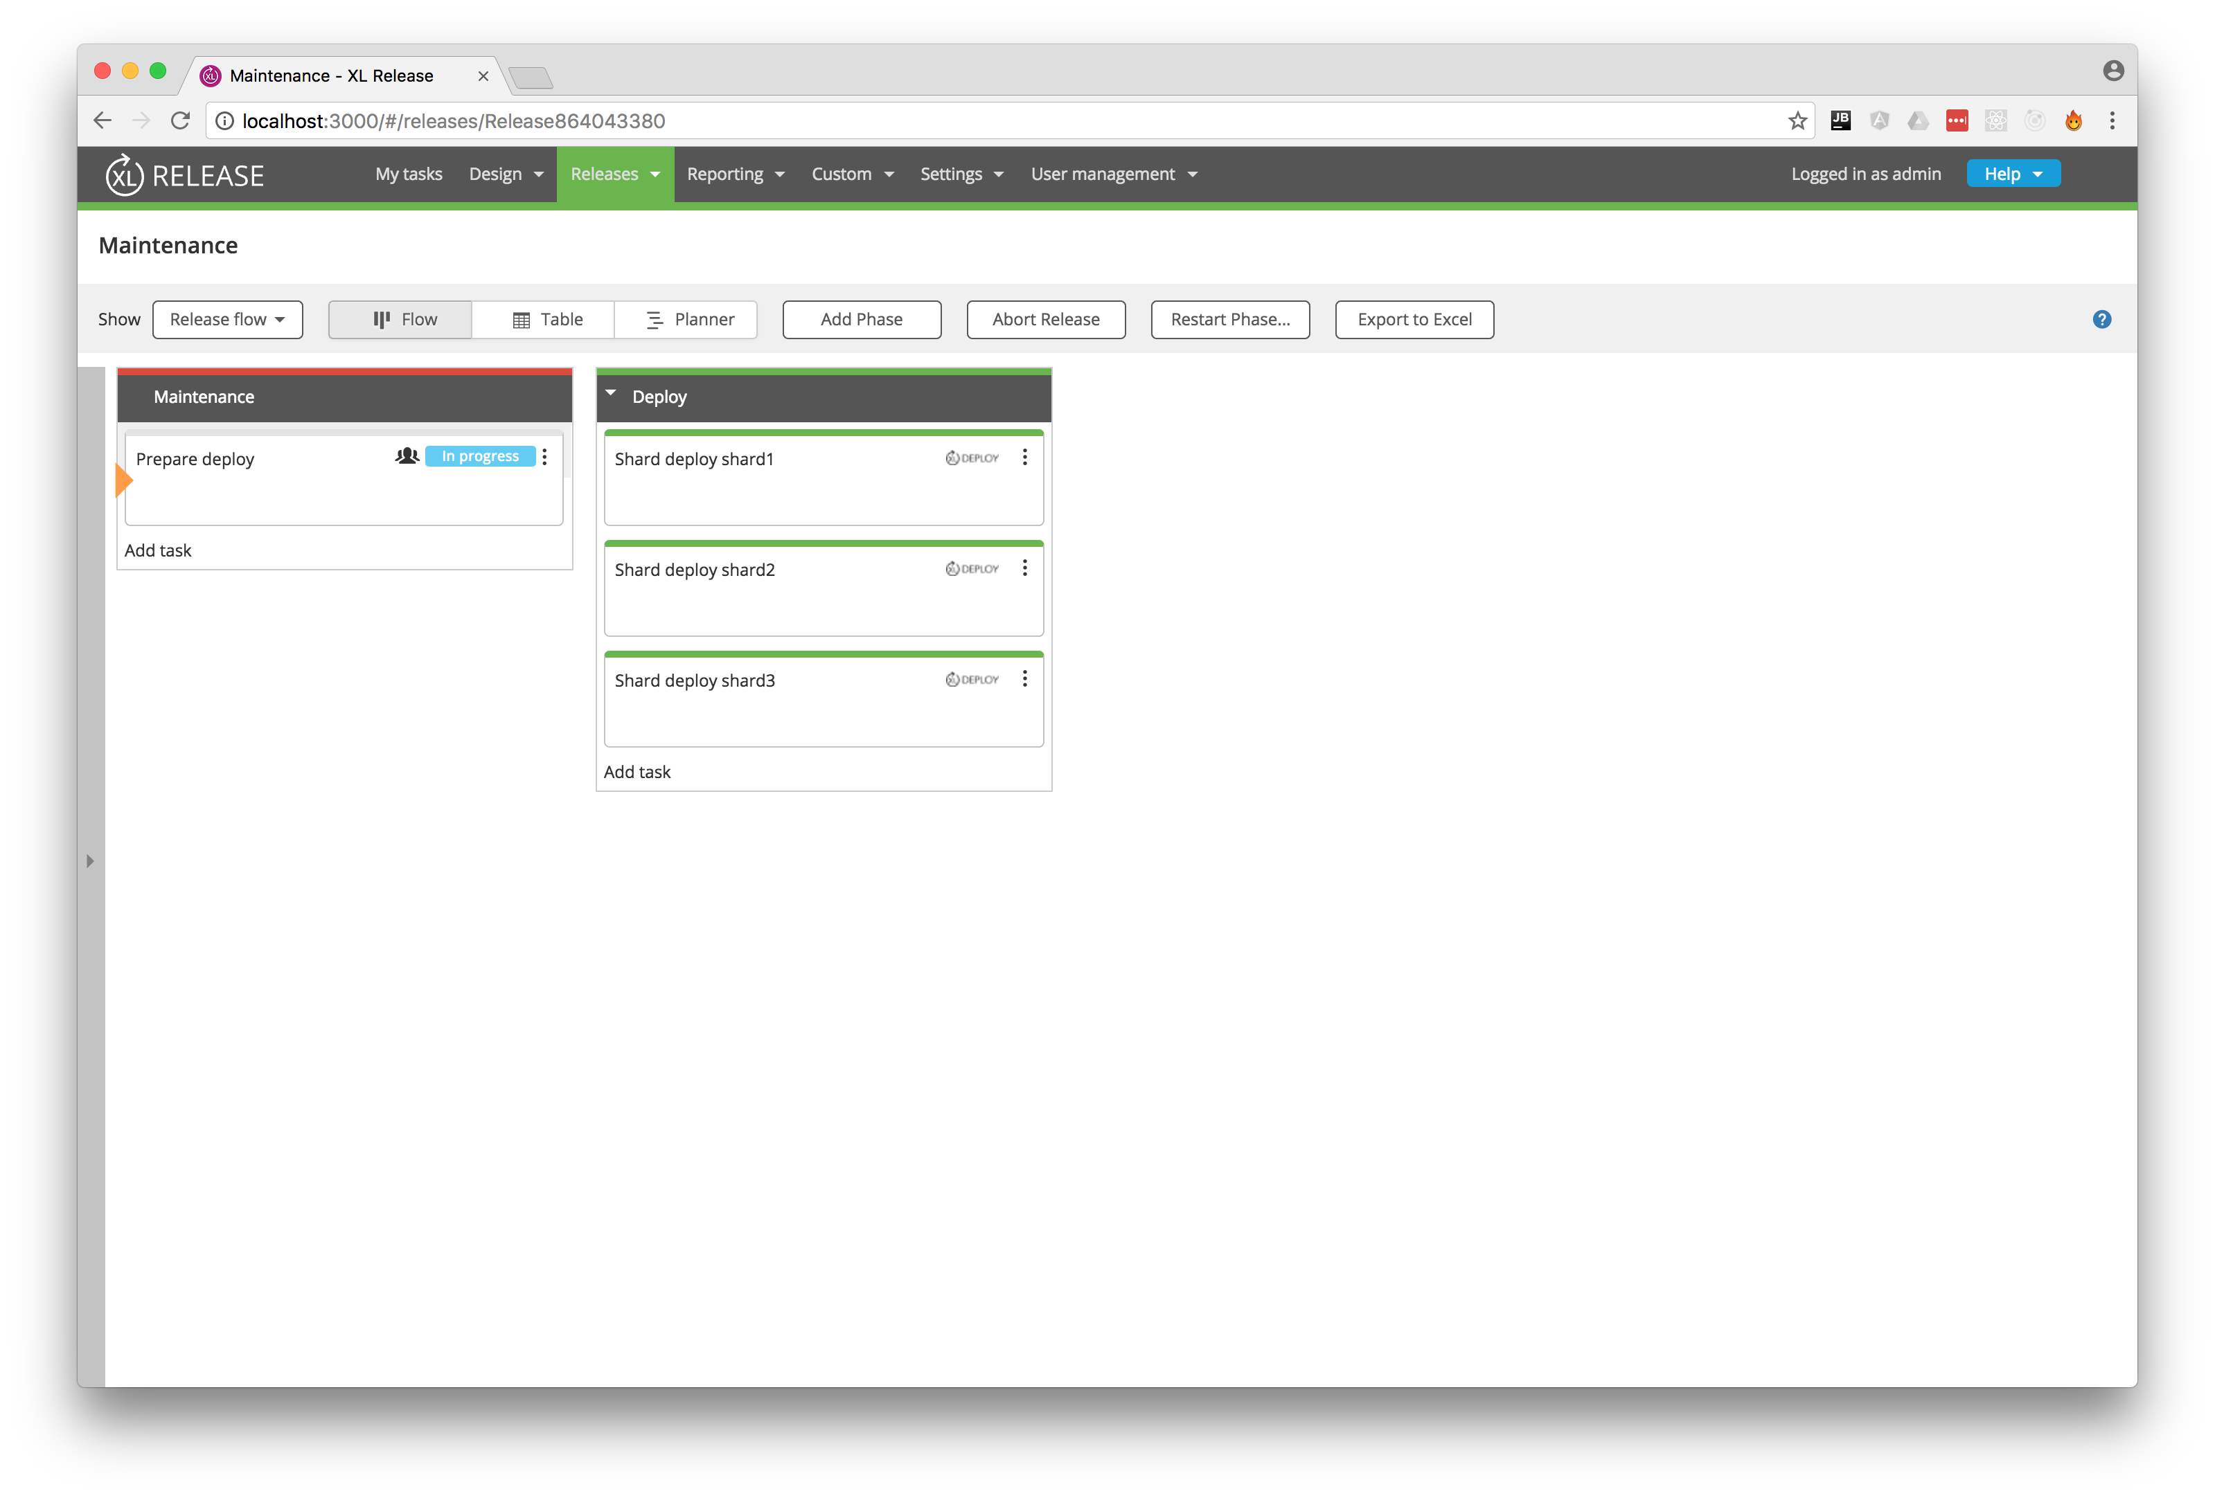
Results of DSL Execution

Slide 26
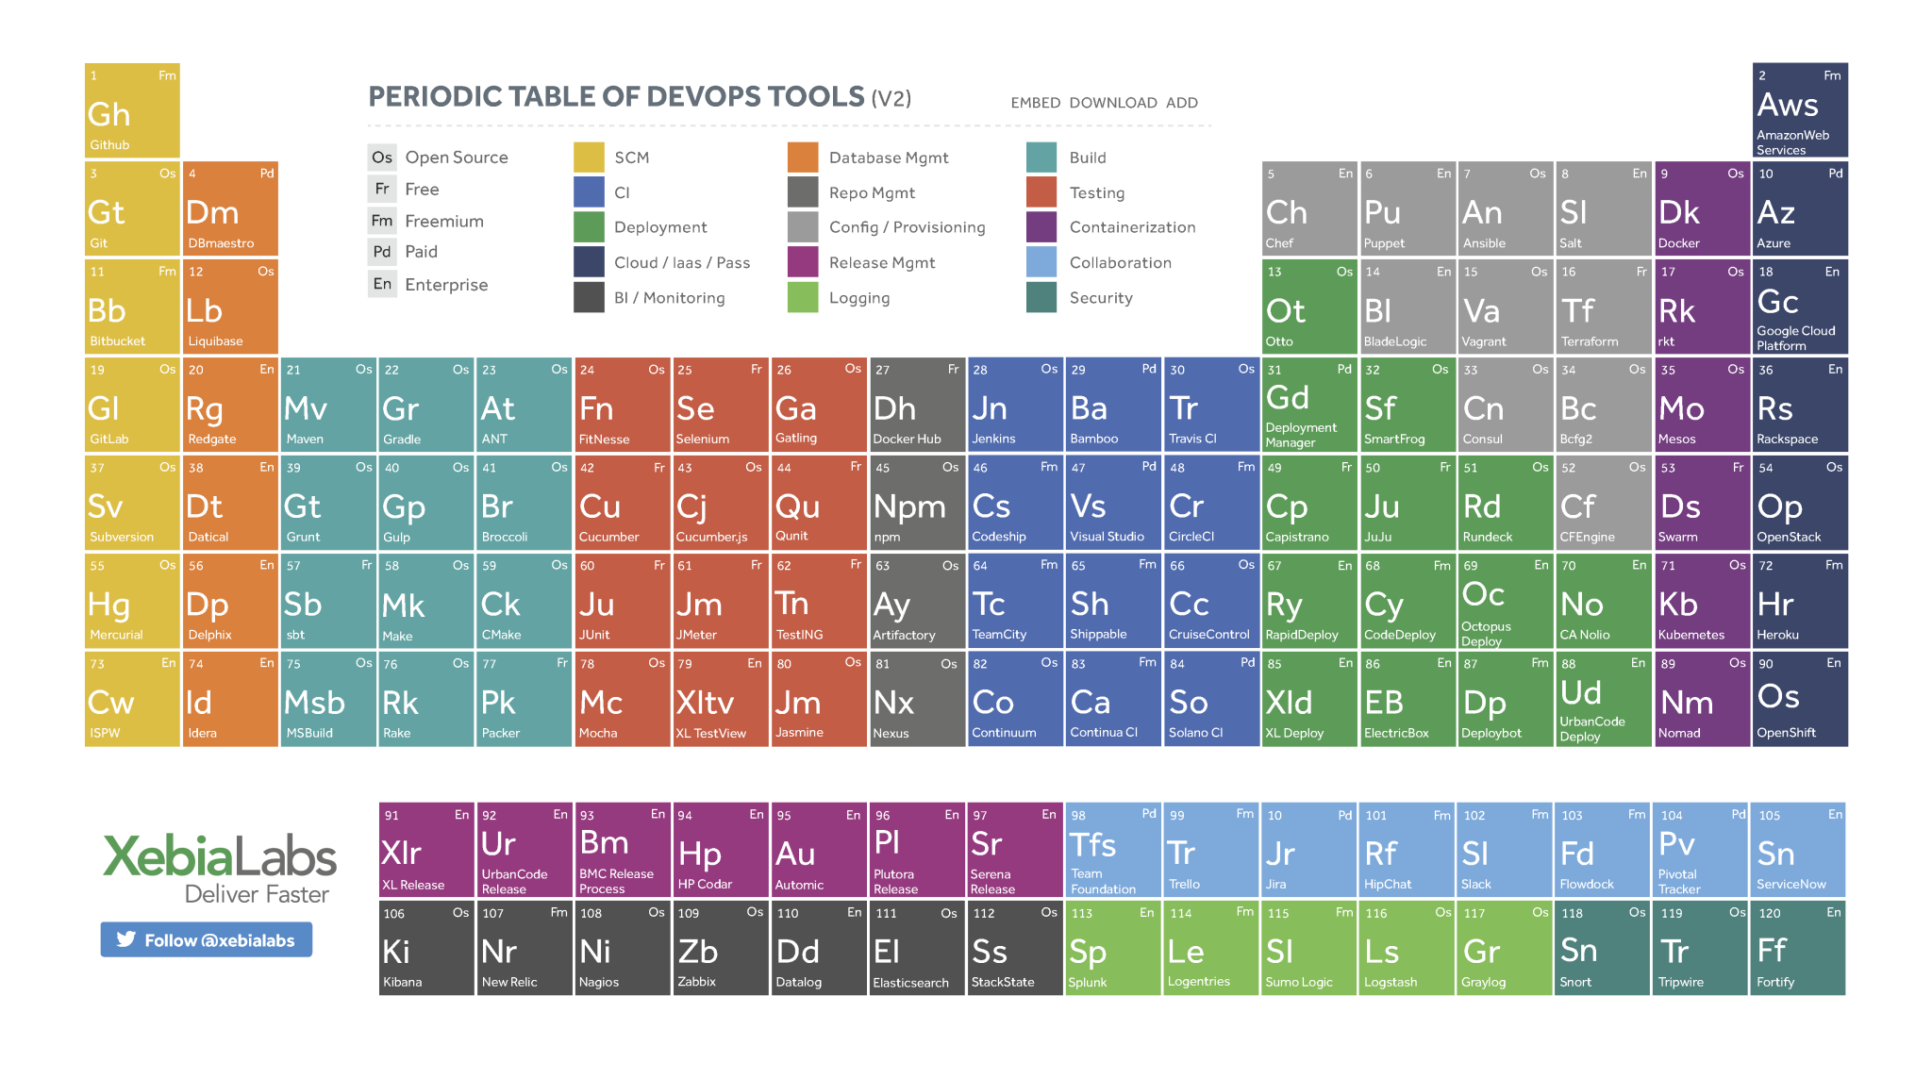
Questions

